Slide 1
Project Title: To Provide Process flow direction / labeling for Gas Receiving Facility (GRF) piping Net Work.
Charter Template
Business Case/ Objectives: Gas Receiving Facility (GRF) Piping Net Work has no flow direction sign(s) / identification labels for easy process appreciation. Thus, this initiative is aimed at providing the requisite directional signs and labelling to aid location employees as well as visitors easy understanding of the piping net work and at a glance appreciate the process flow arrangement to the various customers. Project has pecuniary benefit, if embarked on by a contractor ; it will cost over N3,000,000; considering cost of materials, logistics, labour, FTO, among others.
Potential Benefits & Measurement:
1. Cost saving, over N1,500,000 will be saved as stated above.
2. This initiative will lead to reduction in man hour waste, as it makes the process facility appears smarter and easy to operate.
3. In house arrangement / personal effort; it is time saving, no host community issues or disturbance.
Project Scope/Actions :
1. Site / facility Assessment.
2. Review PEFs.
3. Production of stencils.
4. Define materials needed / material procurement.
5. Prepare PTW.
6. Carry out stenciling and labeling of the main pipings.
7. Housekeeping and work close out.
Critical Success Factors:
1. Project Members availability
2. Asset Leadership/Stakeholder Support
High-level Timeline:
L0-L1: (See definition of L1 – L5 in the next slide)
L2:
L3:
L4:
L5:
Initiative End
Project Sponsor: Onyeka Ikechukwu
Implementation Lead: Omiojieahior, John.
Project Team: Ohagwazua, E. and Dennar, C.

Slide 2
Weekly Cadence Commitment Template Past 7 days
No. | Action | Action Party | Threat | Date | Status
10-4.1 | Site/facility assessment carried out successfully | Omiojieahior, J. |  |  | Completed
10-4.2 | Review PEFs | Omiojieahior, J. |  |  | Ongoing
10-4.3 | Production and preparation stencils | Omiojieahior, J. and project team |  |  | Completed
10-4.4 | Sourcing/procurement of necessary materials; paint, brush, plastic buckets, cleaning materials & other accessories. | Omiojieahior, J. |  |  | Completed
10-4.5 | Prepared PTW/documentations. | Omiojieahior, J. and project team |  |  | Ongoing
10-4.6 | Commenced stencilling labelling of main pipings. | Omiojieahior, J. and project team |  |  | Ongoing
10-4.7 | Stencilling labelling of main pipings on going. | Omiojieahior, J. and project team |  |  | Ongoing
10-4.8 | . Stencilling labelling of main pipings in progress. | Omiojieahior, J. and project team |  |  | Ongoing
10-4.9
10-4.10
10-4.11
10-4.12
10-4.13
10-4.14
10-4.15
10-4.16
Completed
Completed
Completed
Completed
New
On track
At risk
Delayed
Completed

Slide 3
Bi-Weekly Cadence Commitment Template Next 14days
No. | Action | Action Party | Threat | Due Date | Status
10-4.1 |  |  |  |  | New
10-4.2 |  |  |  |  | New
10-4.3
10-4.4
10-4.5
10-4.6
10-4.7
10-4.8
10-4.9
10-4.10
10-4.11
10-4.12
10-4.13
10-4.14
10-4.15
10-4.16
New
On track
At risk
Delayed
Completed

Slide 4
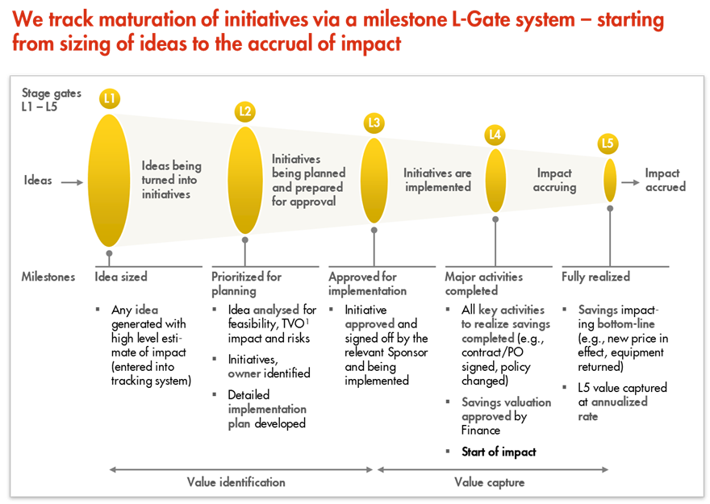
L1 – L5 Gates

